Slide 1
Scala Foundational
Khanh Tran
15 March 2023

Slide 2
Scala & functional programming
Scala lets you write code in an object-oriented programming (OOP) style, a functional programming (FP) style, and even in a hybrid style, using both approaches in combination
Functional programming is a style of programming that emphasizes writing applications using only pure functions and immutable values

Slide 3
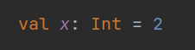
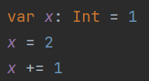
Value, Variable
val is immutable (can’t be reassigned)
var is mutable
In Functional Programming we prefer val than var
All vals and vars have types
Compiler automatically infers types if we don’t define

Slide 4
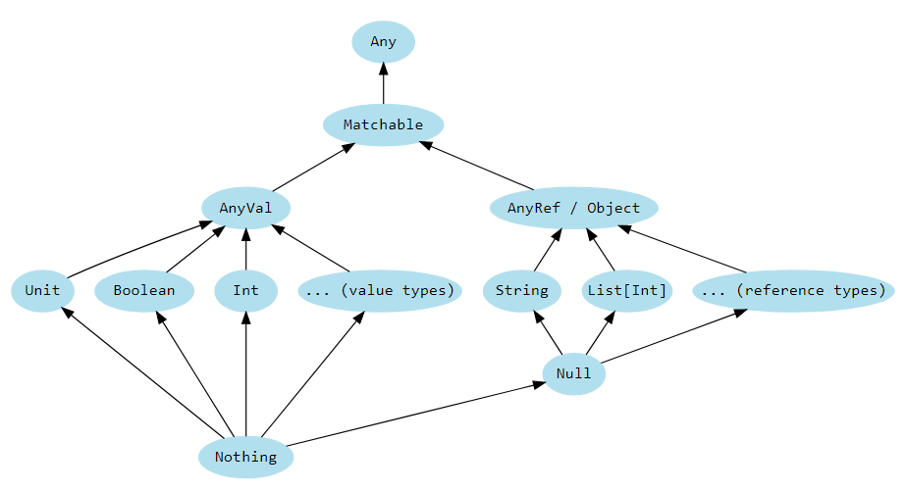
Type
Any is top type. It defines universal methods equals, hashCode, and toString
Matchable is used to mark all types to perform pattern matching
AnyVal represents value types (non-null) like primitive types in Java
AnyRef represents reference types. User-defined type is subtype of AnyRef, can be null.
Unit is used as void in Java. No value to return
Null is unsafe. Use Option instead
Nothing is a type nothingness ☺ used to signal non-termination, such as a thrown exception, program exit…

Slide 5
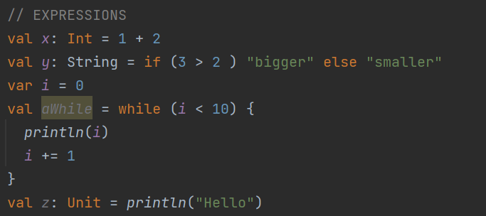
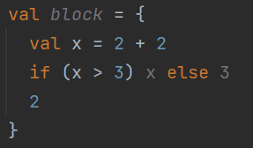
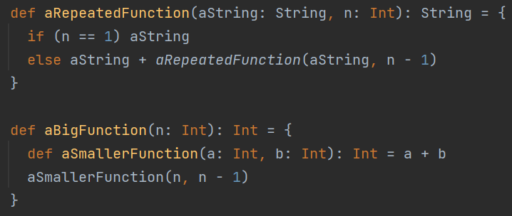
Expression & Function
In Scala, operators, if else … or even loop, println are expressions because they can return some values
The value of a block is the value of its last expression
Functions are trees of expressions that each return a value

Slide 6
Stack & Tail Recursive
Recursive is very popular in Scala
When you need loop to calculate something, use tail recursive
Write a factorial function using
While loop
Recursive
Tail Recursive

Slide 7
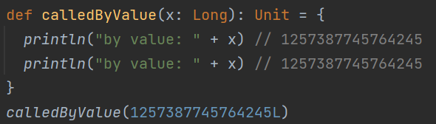
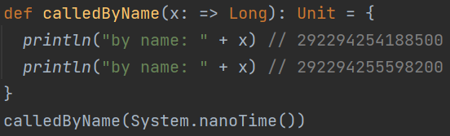
Call by value vs Call by name
Call by value
Value is computed before call
Same value is used everywhere
Call by name
Expression is passed
Expression is evaluated every run

Slide 8
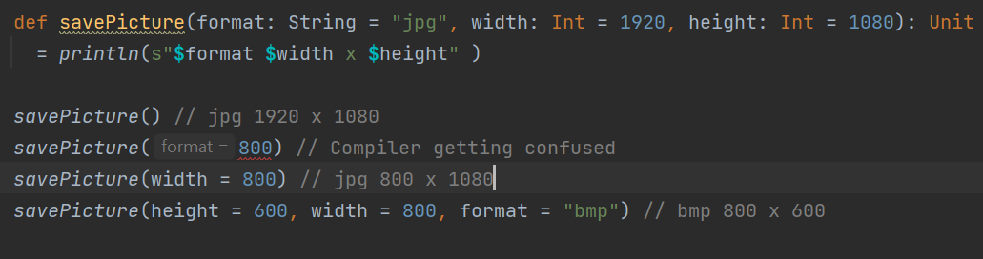
Default Arguments
Use default when we often call function with same values
Name Arguments to avoid compiler getting confused

Slide 9
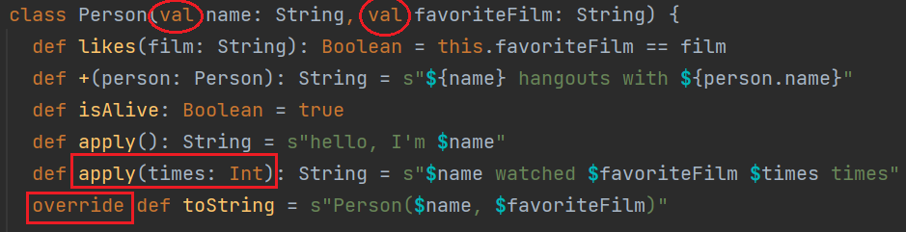
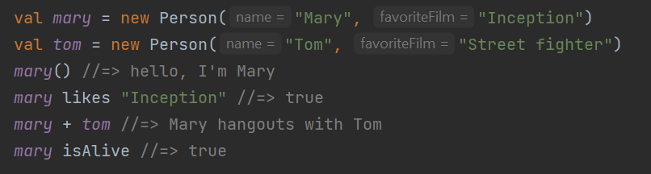
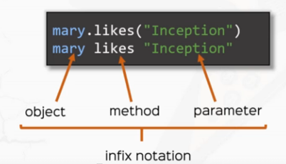
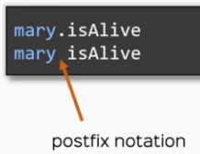
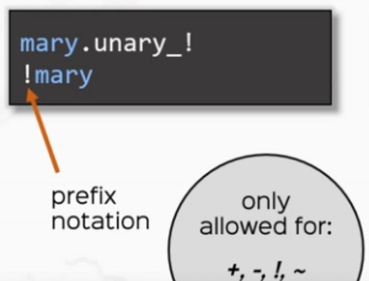
OOP Basic and Method Annotation
Define a class
Parameters vs fields
Define methods
Overriding, Overloading
Instantiate
Implement apply method allows to call object as a function
Method annotations make Scala close to natural language
Infix annotation for method with one parameter
Postfix annotation for method with no parameter
Prefix annotation only allowed for +,-,!,~

Slide 10
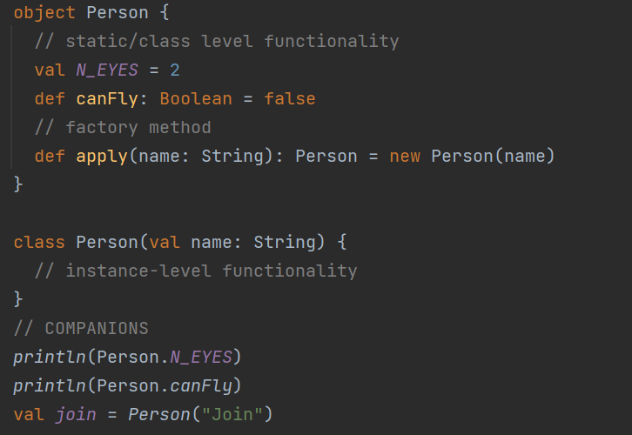
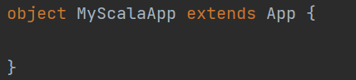
Object & App
Scala doesn’t have “static” values/methods
Scala object
An object is a class that has exactly one instance
An object is a singleton
Scala companion
Class and Object are companions
They have the same name
Both must be defined in the same file
Scala Application = Object with main method
def main(args: Array[String]): Unit

Slide 11
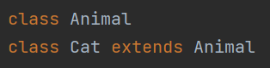
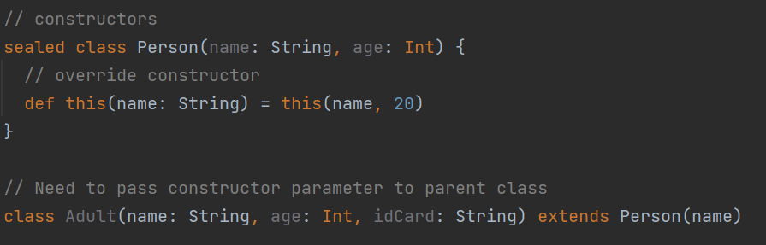
Inheritance
No modifier means public
Need to pass constructor parameters to parent class
Derived classes can override members or methods
Reuse parent fields or methods with super
Prevent Inheritance with final and sealed
Declaring sealed restricts where we can define its subclasses — we have to define them in the same source file.

Slide 12
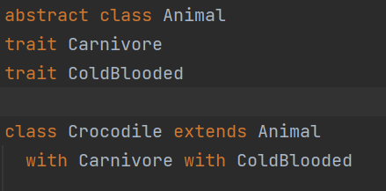
Abstract Class & Trait
Both Trait and Abstract Class can have either abstract or non-abstract (implemented) methods
Both Trait and Abstract Class cannot be instantiated
Different between Abstract and Trait
Trait = behavior
Abstract Class = thing
Inherits from one Abstract Class but multiple Traits
Note: A Class cannot inherits from 2 Traits that have same non-abstract method (Diamond problem )

Slide 13
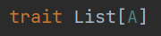
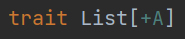
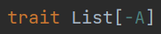
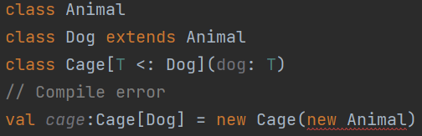
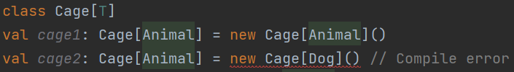
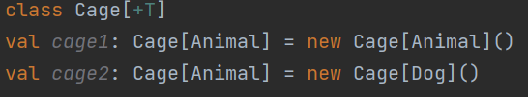
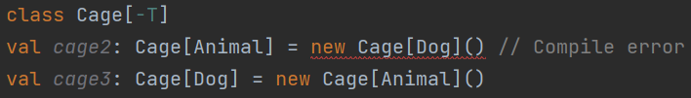
Generic
Variance
List[A] – invariant
List[+A] – covariant
List[-A] – contravariant
Bounded Types
[T <: A] – upper type bounds
[T >: A] – lower type bounds
The variance question: if A extends B, should Thing[A] be a subtype of Thing[B]?
Invariant (no)
Covariant (yes)
Contravariant (no - backwards)

Slide 14
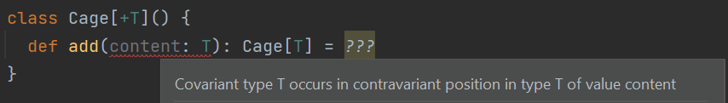
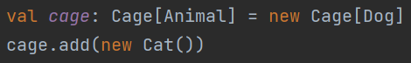
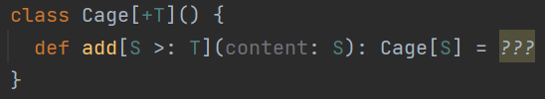
Generic (Continued)
Variance rules
Types val fields are in covariant position
Types of var fields are in covariant AND contravariant position
Types of method arguments are in contravariant position
Method return types are in covariant position
we solve the “covariant type occurs in contravariant position” by “widening”: we add a type argument [S >: T] and change the argument type to S
we solve the “contravariant type occurs in covariant position” by “narrowing”: we add a type argument [S <: T] and change the method return type to S
You got error because of breaking rule 3. That rule is to prevent this problem
But what if we want to have a cage that holds everything
Solution: add a type argument [S >: T] Compiler will infer the type S that can cover both Cat and Dog => Animal

Slide 15
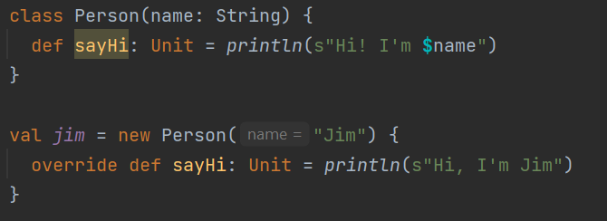
Anonymous Class
Works with traits and classes (abstract or not)
Rules
Required pass in constructor arguments
Implement all abstract fields and methods

Slide 16
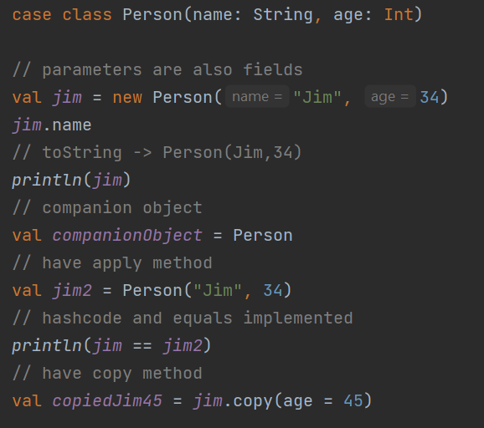
Case Classes
Case Class is Scala specific concept to avoid re-implementing all sort of boilerplate code.
Class parameters are fields
toString, equals and hashCode implemented
Have companion objects
Have handy copy method
Are Serializable so that we can send instance of Case Class through the network
Have extract pattern
Case objects act in the same way as cases classes but they don’t have companion objects

Slide 17
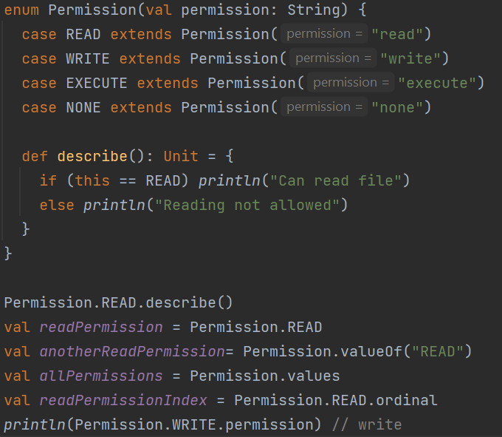
Enums
This Enums is sealed class, Permission, with 4 values, READ, WRITE, EXECUTE, NONE .
The Permission values are members of Permission companion object.
Similar to Class, Enums can have constructor, field, method

Slide 18
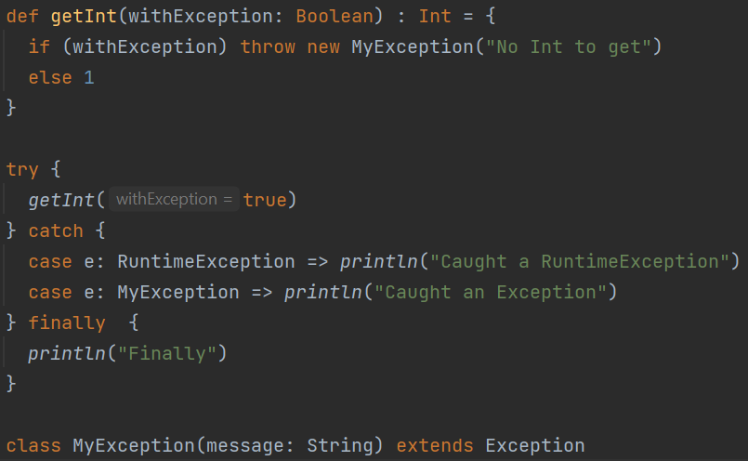
Exceptions
Similar to Java, use try catch finally expression to handle exception
You can create your own exception

Slide 19
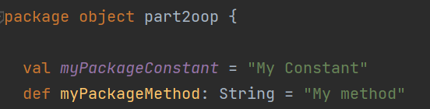
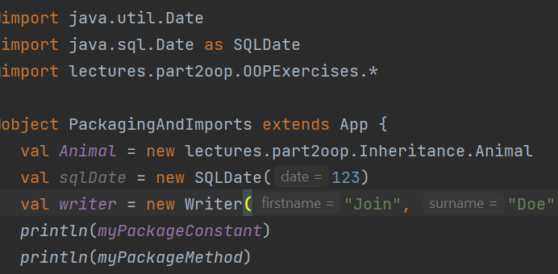
Packaging and Import
Package and Import
Fully qualified name
Import all
Default import (String, Int …)
Definitions (method, constant..) inside package object can be accessed across an entire package without importing

Slide 20
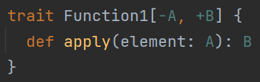
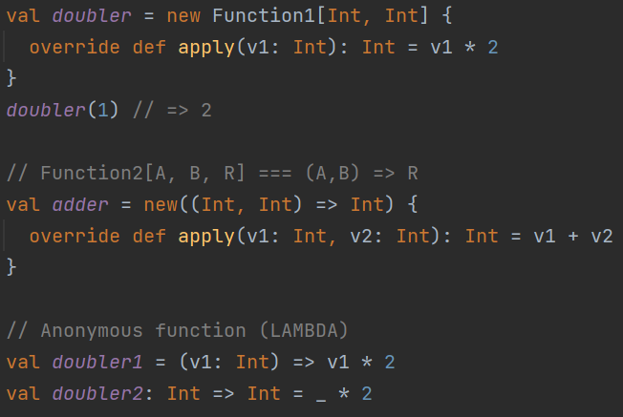
Functional Programming with JVM
The original design of the JVM is for OOP
Scala uses instances of classes to simulate functional programming
Function trait, up to 22 params
Syntactic sugar function type
Anonymous Function (LAMBDA) Use function as values
Use function as values

Slide 21
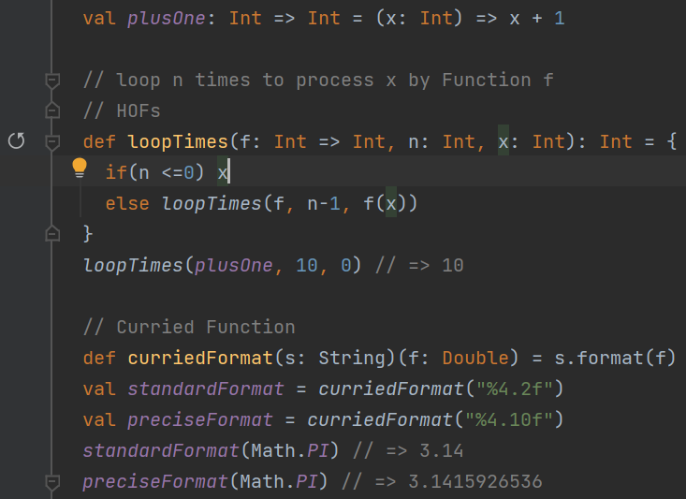
Higher-Order-Functions (HOFs) and Curries
HOFs
Use function as values
Pass function as parameter
Currying
Function with multiple parameter lists

Slide 22
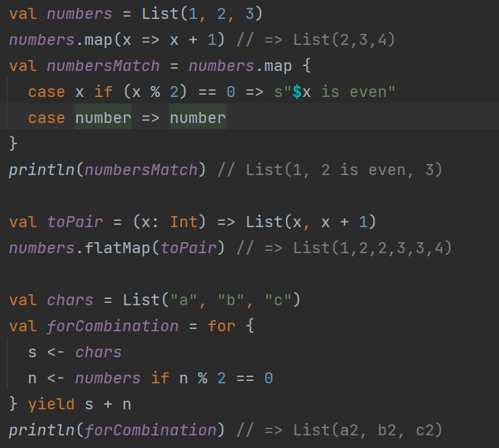
map, flatMap, filter, for
Map, flatMap, filter methods are similar to Java language
Use for-combination for nested loop

Slide 23
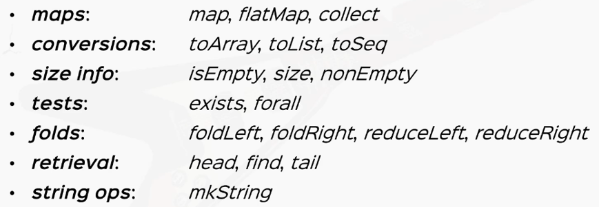

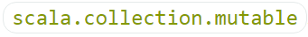
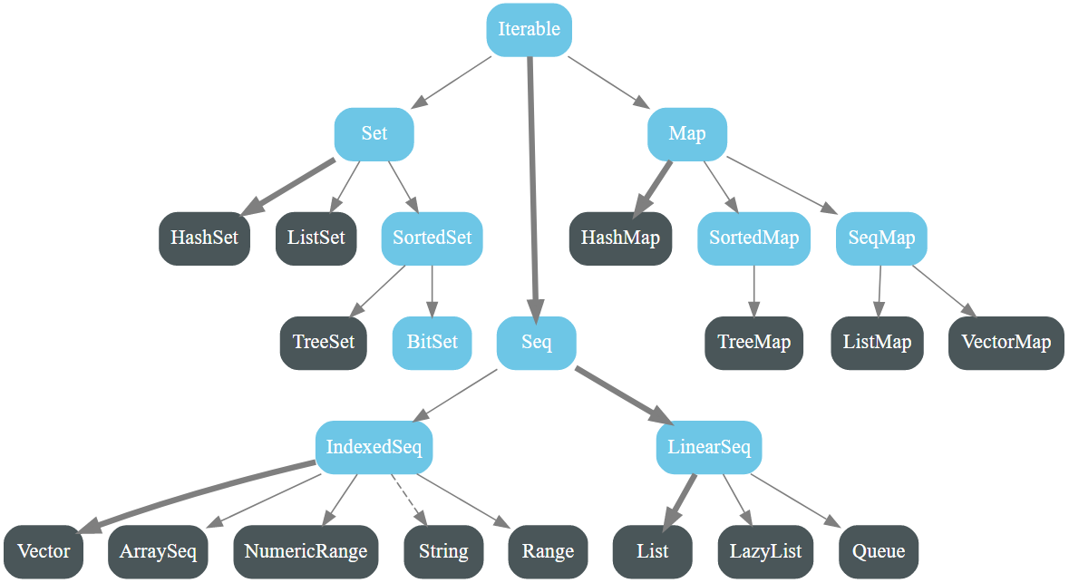
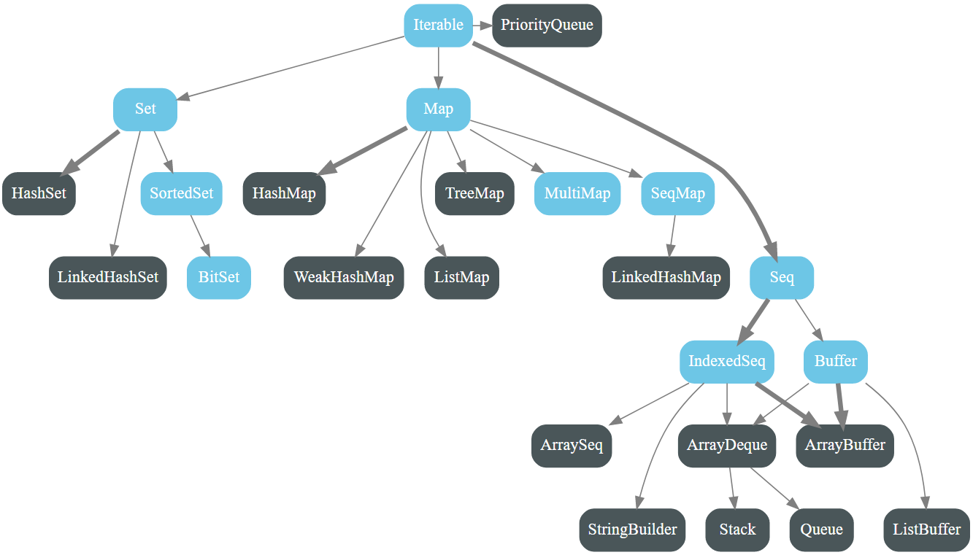
Collection
Iterable is base trait for all collections. It offers many of useful methods

Slide 24
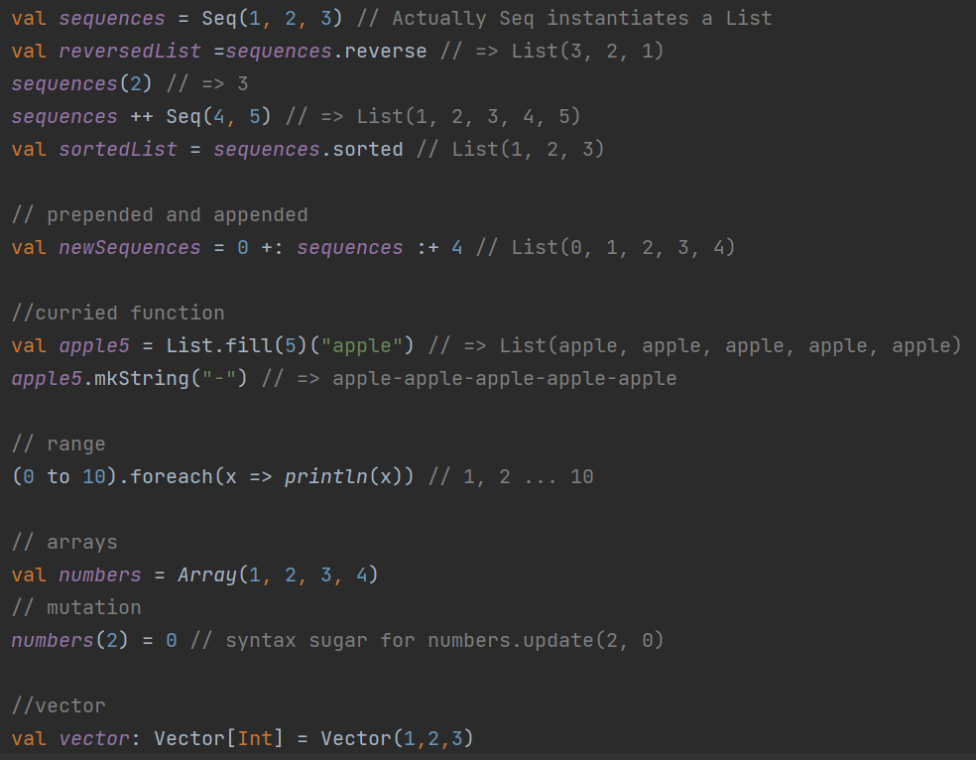
Sequences: List, Array, Vector
List
Immutable linked list
Head, tail, isEmpty methods
Array
Can be constructed with predefined length
Can be mutated (updated)
Vector
Immutable sequence
Fast addition: prepend/ append
Good performance on large size

Slide 25
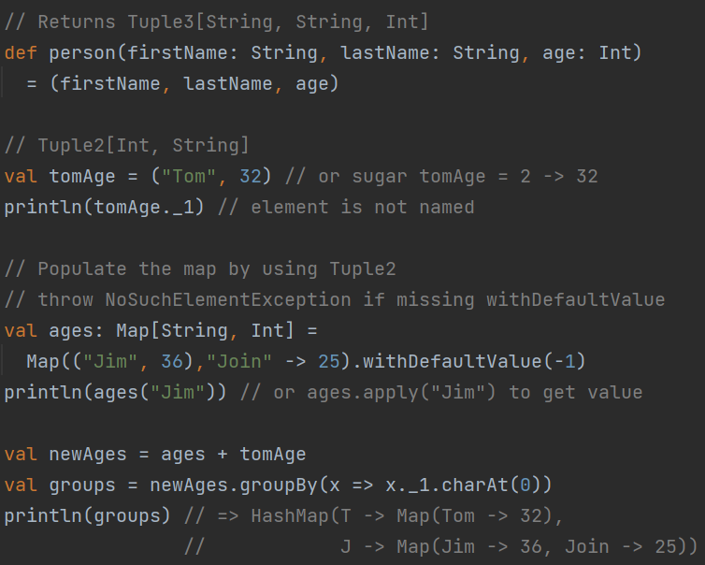
Tuple & Map
Tuple and Map are mutable
Tuple
Dataset contains a fixed number of elements (up to 22 elements)
Use to populate Map, return values from method …
Elements are not named
Functional on Tuple: copy, swap…
Map
Functional: map, flatMap, view.filterKeys, view.mapValues
Conversion: to/from collection, groupBy

Slide 26
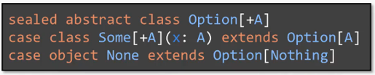
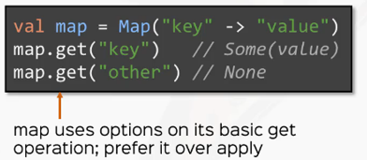
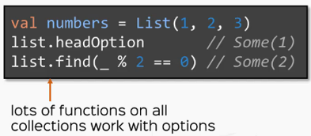
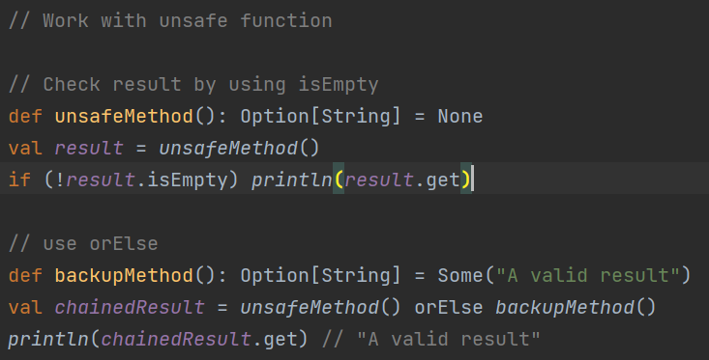
Option
Option help to void error resulting by null value
Some wraps concrete value
None is singleton for absent value
Presents in many places in Scala
Design your unsafe function use Option[return type]
Utilities on Option: map, flatMap, filter, for-combination

Slide 27
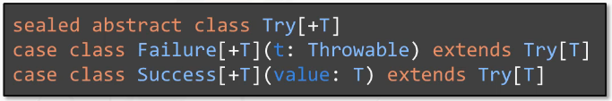


Failure Handling
Try-catch expression problem
Make the code hard to follow
Boilerplate code
Nested try catch is nightmare
A Try[T] is a wrapper for computation that might fail or not
Avoid runtime crashes
Endless mount of try-catches
Design your unsafe function using Try[return type]
Utilities on Try: map, flatMap, filter, for-combination

Slide 28




Pattern Matching
Like Switch-Case from other languages but much more powerful
Decompose values into
Cases are matched in order
Use case _ to cover the rest of cases. If not, Scala will throw MatchError
Return type of match is unified type of all types in all cases
You can see Pattern Matching anywhere in Scala

Slide 29


Intellij with ScalaTest
Add the ScalaTest dependency to your build.sbt
libraryDependencies += "org.scalatest" %% "scalatest" % "3.2.15" % Test
Test classes will have the same structure with source
We will use FunSuite, one of popular option from the ScalaTest framework

Slide 30

AnyFunSuite
Use “test” to define test cases
Use “ignore” method to disable a test or @Ignore to ignore entire suite of tests
Use Informers (GivenWhenThen) to provide information for testing steps
Use “markup” to create extra document for test case
Use “pending” the define tests that not yet implemented (sketch out before tests)

Slide 31

Mocking frameworks
There are vary mocking frameworks that can be used with ScalaTest. In this session, I choose Mockito because it is familiar with Java developer
Add Mockito dependency to sbt
libraryDependencies += "org.scalatestplus" %% "mockito-4-6" % "3.2.15.0" % "test“
Use “before” and “after” to setup and tear down your test data

Slide 32
JDBC Connection & SQL

